Slide 1
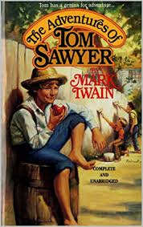
THE ADVENTURES OF TOM SAWYER

Slide 2
Alla fine di questo anno scolastico molto diverso e particolare, si è concluso all’insegna dell’avventura, anche il PON «It’s Easy». Questo corso fatto attraverso una metodologia insolita, la DAD (didattica a distanza) ha visto i ragazzi delle classi 2^ della nostra scuola secondaria di primo grado, impegnati nella lettura (guidati dalla docente esperto di madrelingua) del classico «The Adventures of Tom Sawyer», attraverso la quale hanno sperimentato il piacere di addentrarsi nello scenario di una lingua mondiale, potenziando, al contempo, la conoscenza della lingua inglese. Dopo uno studio approfondito di questo classico che rimane comunque una storia molto vicina e apprezzata dai giovani di oggi, i ragazzi hanno realizzato con grande entusiasmo il seguente lavoro.
Prof.ssa Giovanna Currado

Slide 3
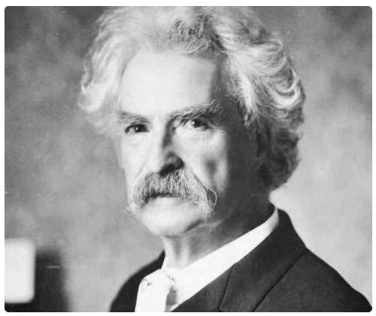
The Author: Mark Twain

Slide 4
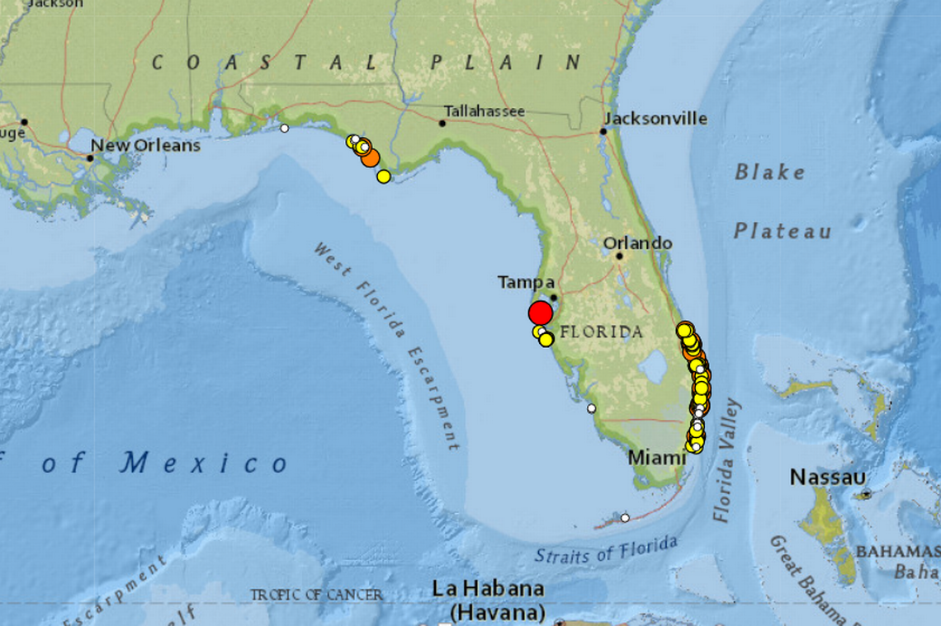
Where was he born?
His real name was Samuel Langhorn Clemens
Born in Florida, Missouri, he spent his early childhood in Hannibal, a town on the banks of the Mississippi.

Slide 5
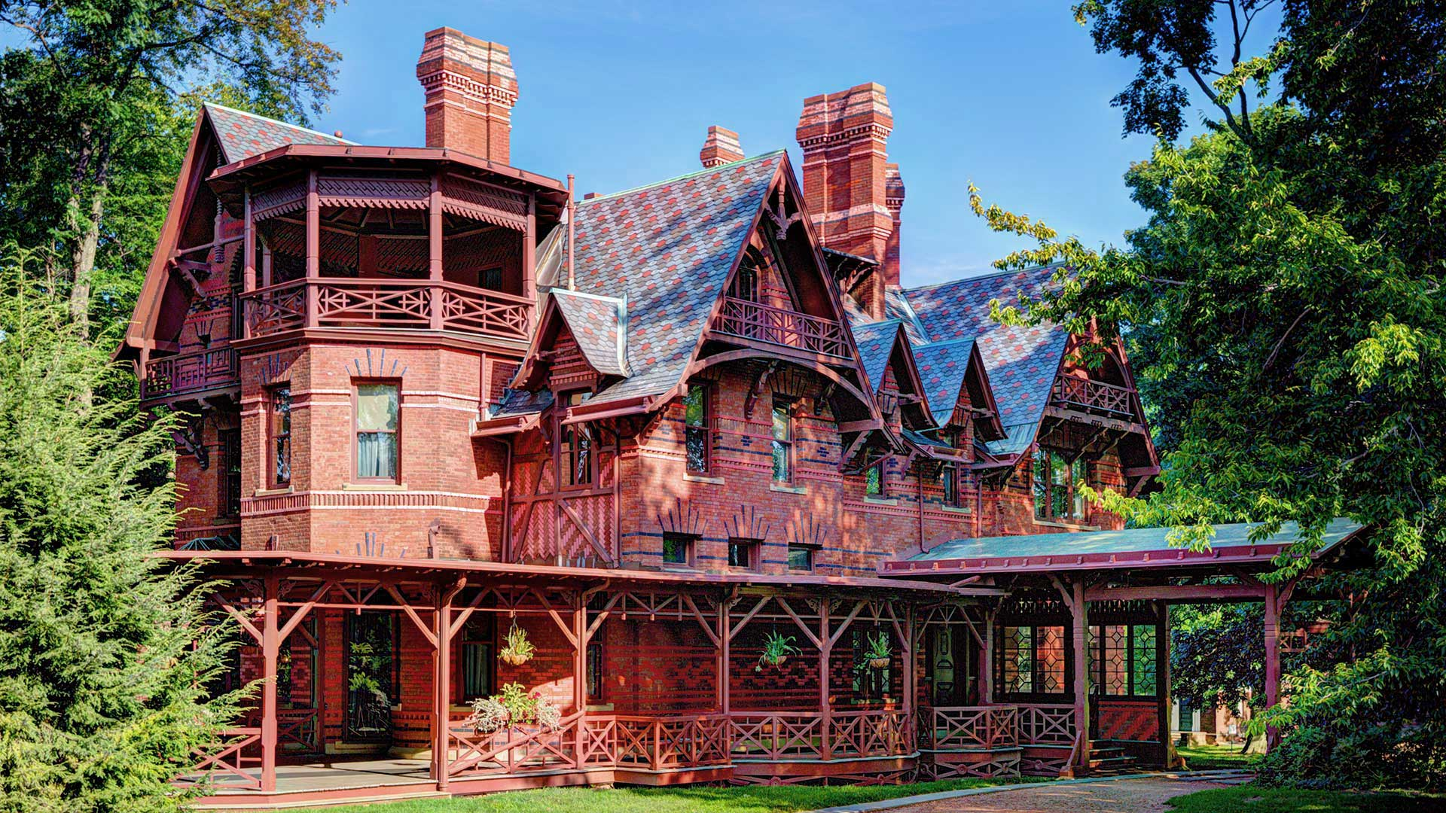
HIS LIFE
He was orphaned of his father at the age of twelve, he had to learn a trade soon.
He became a printer and worked in Iowa and New York. When he started writing, Samuel took on the pen name Mark Twain. The name comes from a term used on steamboats to signal that the water was 12 feet deep.

Slide 6
HIS WORKS
He also started writing for the newspaper of his hometown and in 1852 published the first story. From 1857 to 1861 he sailed on the boats of the Mississippi, becoming a pilot.
From 1865 his stories, first published in various magazines and then collected in volumes, gained increasing success, making him the most widely read writer in America in a short time. His most important works are: The Adventures of Tom Sawyer (1876) and The Adventures of Huckleberry Finn (1884). At the same time he undertook an incessant lecturer activity that took him around the world.
He married Olivia Langdon and had 4 children ( of whom 3 died)
He died depressed and tired after receiving an honorary degree in Letters from the University of Oxford in 1907.

Slide 7
MARK TWAIN’S QUOTES
By Gabriele Montesano 2B

Slide 8
“Keep away from people who try to belittle your ambitions. Small people always do that, but the really great make you feel that you can become great too”.
In questa citazione, Mark Twain afferma che le persone da poco tentano di frenare le nostre ambizioni e di denigrare chiunque; invece le persone veramente grandi, non feriscono né ostacolano le nostre azioni, bensì ci forniscono un esempio da seguire.

Slide 9
“Twenty years from now you will be more disappointed by the things you didn’t do than by the ones you did do. So, throw off the bowlines. Sail away from the safe harbor. Catch the trade winds in your sails. Explore. Dream. Discover.”
Con questa citazione, sempre attuale, Mark Twain esprime la sua opinione sulle opportunità da cogliere nella vita. Questa sua importante citazione sta a significare che bisogna sempre cogliere le opportunità nel momento giusto e mai lasciarle andare, anche se questo può significare l’ abbandono di un “porto sicuro” che potrebbe essere la propria casa o la propria famiglia. Alla fine dice: «Cattura i venti dell’ opportunità nelle tue vele». Paragona le opportunità ai venti che sono indispensabili per il movimento di una nave paragonata alla vita.

Slide 10
“Everyone is a moon, and has a dark side which he never shows to anybody”.
In quest’ ultima citazione, Mark Twain, evidenzia il lato segreto di ogni persona paragonandola alla Luna. Con una piccola frase riesce a descrivere la mente di ogni essere umano che, per quanto possa essere aperto verso il mondo esterno e verso gli altri, avrà sempre qualche segreto celato che non verrà rivelato a nessuno.

Slide 11
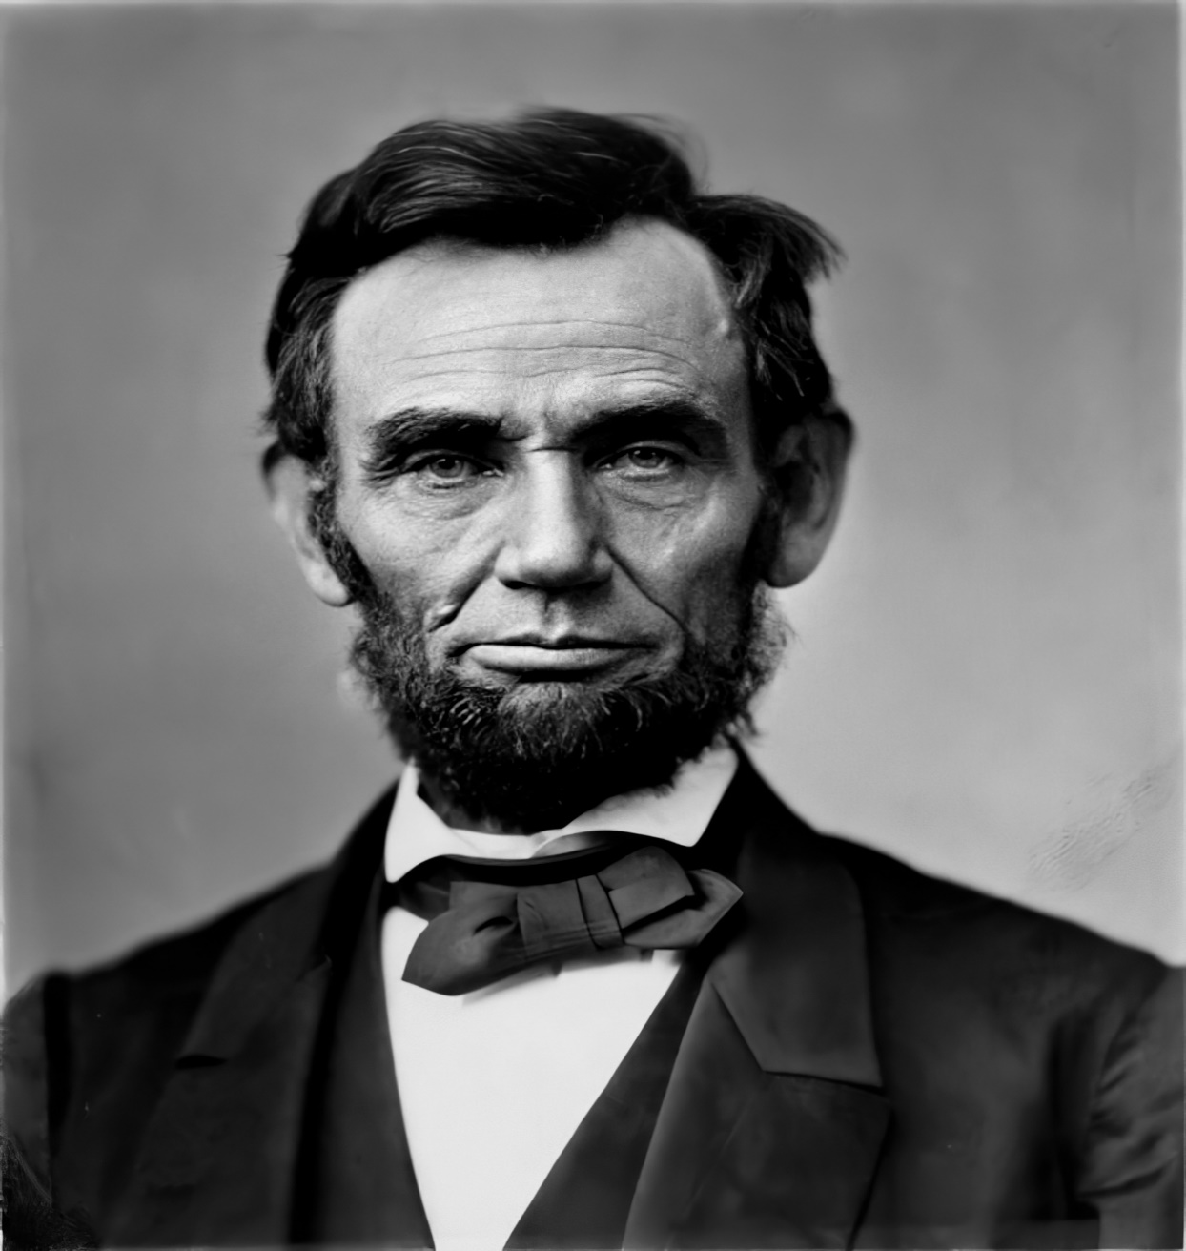
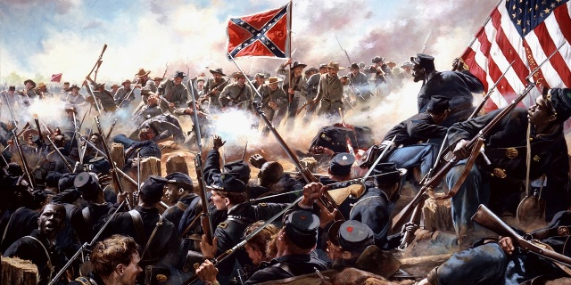
The 1800s in the United States
𝑩𝒚 𝑫𝒆𝒏𝒊𝒔𝒆 𝑻𝒐𝒍𝒐𝒎𝒆𝒐 2A

Slide 12
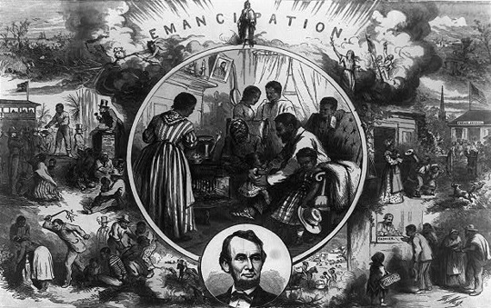
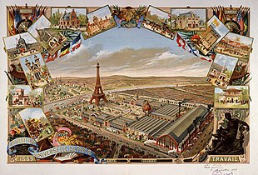
The USA in the times of The Adventures of Tom Sawyer
The 19th century saw large amounts of social change; slavery was abolished, and the First and Second Industrial Revolutions led to massive urbanization and much higher levels of productivity, profit and prosperity. The empires were formally dissolved and European imperialism brought much of South Asia, Southeast Asia and almost all of Africa under colonial rule.

Slide 13
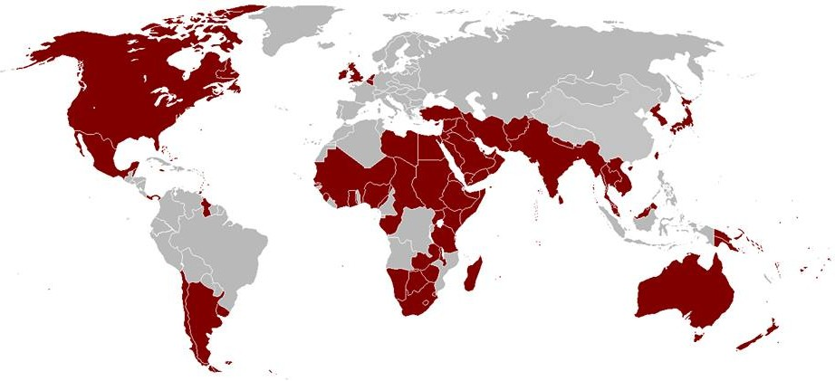
The British Empire grew rapidly in the first half of the century, especially with the expansion of vast territories in Canada, Australia, South Africa and heavily populated India, and in the last two decades of the century in Africa. By the end of the century, the British Empire controlled a fifth of the world's land and one-quarter of the world's population.

Slide 14
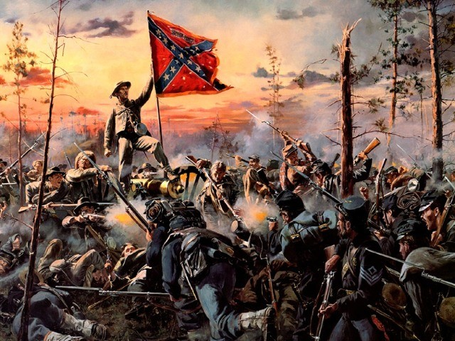
The American Civil War
The American Civil War was a civil war in the United States from 1861 to 1865, fought between northern states loyal to the Union and southern states that had seceded from the Union to form the Confederate States of America. The civil war began primarily as a result of the long-standing controversy over the enslavement of black people. War broke out in April 1861 when secessionist forces attacked Fort Sumter in South Carolina shortly after Abraham Lincoln had been inaugurated as the president of the United States.The loyalists of the Union in the North, proclaimed support for the constitution. They faced secessionists of the Confederate States in the South, who advocated for states’ rights to uphold slavery.

Slide 15
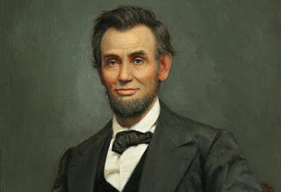
Abraham Lincoln
Abraham Lincoln was an American statesman and lawyer who served as the 16th president of the United States (1861–1865). Lincoln led the nation through its greatest moral, constitutional, and political crisis in the American Civil War. He preserved the Union, abolished slavery, strengthened the federal government, and modernized the U.S. economy.

Slide 16
THE SUMMARY OF THE STORY

Slide 17
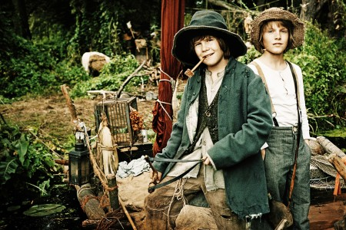
Tom Sawyer lived with his aunt Polly because his parents were dead. He loved to play and adventure. One Friday he didn't go to school and his aunt Polly had him paint an entire fence as punishment. Tom convinced his friend to paint the fence for him in exchange for fruit.
There was a new girl in the yard. She returned to her house, Tom waited for her, but she did not return. Her aunt was happy because Tom had painted the fence.
Tom's friend Huck didn't have a home. Huck's father is a drunkard. In the city nobody loved him. Tom didn’t go to school and was sitting next to Becky. As they returned home Tom declared himself to Becky and the girl to him .Becky got angry because she discovered that Amy was Tom's promised girlfriend. At midnight Tom met Huck and they went to the graveyard. They heard noises and hid behind some trees: it was Doctor Robinson, Injun Joe and Muff Potter who were arguing. Injun Joe kills the doctor with his knife. The boys ran away frightened and decided not to say anything to anyone. Injun Joe accused Muff Potter.
Becky was sick and did not go to school so Tom was sad told his aunt that he also was sick and couldn’t go to school either. Her aunt gave Tom some medicine which he gave to the cat Peter who ran out the window. Aunt Polly saw everything and made Tom go to school. On the way to school Tom met Joe they both didn't want to go to school, but they changed their mind because Becky was no longer sick and had gone back to school. Later Joe, Tom and Huck went to the river for an adventure, but returned home because they didn't have food.

Slide 18
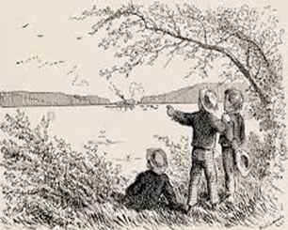
The three boys returned to the river. They crossed the river with a small boat that they found there. It was a wonderful place because there was no school and they could play all the time. In the afternoon they heard noise coming from a boat on the river: there was a man who was looking for them to bring them home. That night Huck and Joe went to sleep, but Tom didn't, he returned home and hid under the bed and heard Aunt Polly tell her friends that she was sad because her nephew Tom was dead. Tom ran away and went back to the river. On Sunday the three boys decided to go back home and went to church and everyone was surprised and happy to see them.
Tom was at school and all his friends wanted to hear about his adventures. He loved to tell everyone about it. Then Tom talked to Amy and Becky got angry. When he noticed it Tom apologized to Becky. Once back in class, Becky saw a book on the chair, flipped through it to see the figures, when she heard the teacher coming back to the class, she put it on the desk. The teacher took it and found it torn and he asked who was responsible. Tom took the blame.
On his way home he saw Becky waiting for him at the fence.
Becky leaves with her family for the summer holidays. Tom was sad. The Muff Potter trial began. Huck and Tom were afraid of Injun Joe and didn't talk to anyone about what they had seen, but they wanted to help Mr. Potter. They brought him some food. Tom was interrogated during the trial and said that he was in the graveyard that evening and that he had seen Injun Joe kill the doctor.
Tom wanted to have an adventure not to think about Injun Joe. With Huck they went to find the treasure in the old house near Mrs Douglas' house. Once inside, suddenly they heard noises from the kitchen; it was Injun Joe with a friend of his who was digging part of the floor with a knife. They pulled out a trunk with lots of money in it. Injun Joe wanted to hide the box under a cross. The men left and the boys went home.

Slide 19
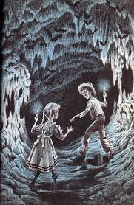
In August Becky and her family returned from vacation. Tom was very happy. Becky, Tom and their friends decided to have an adventure on the river. They entered the cave. When it was evening everyone except Tom and Becky went home. Tom and Becky were lost in the cave.
Huck had not gone to the river because he was not well. He had decided to keep an eye on Injun Joe's house. One evening Injun Joe and a friend of his came out of the house with the treasure in his hand. Huck followed them to Mrs Douglas' house. The two men wanted to kill her. Huck went to ask Mr Jones for help. Mr Jones and his sons went to Mrs Douglas' house and this way they saved her.
Meanwhile Tom and Becky were looking for a way out of the cave. But Becky was tired and Tom told her to wait for him there. Tom went to find a way out, but found a man: it was Injun Joe who was hiding his treasure under the cross. Tom went back to Becky, but said nothing to her. He went to the opposite side to find a way out. Then he saw a light coming from a small door. He and Becky got out of the cave and went home.
Tom went to Becky's house and talked to her father. Tom told the judge everything. So they decided to go back to the cave. They found Injun Joe dead and Huck and Tom put the treasure money in small bags and took it home.

Slide 20
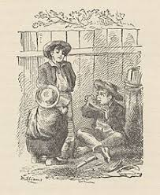
The two boys wanted to hide the treasure in the old house but were blocked by Mr Jones who took them to Mrs Douglas' house. Once there they changed their clothes and met all the villagers, Mrs Douglas wanted to give Huck a house and some money, but the boys let everyone see Injun Joe's treasure.
Huck lived with Mrs Douglas. He had everything but he wasn't happy because he wanted to be free. So he decided to run away, but Tom told him that if he didn’t go back they would no longer be friends.They decide to go on another adventure that night with other friends.

Slide 21
THE STORY PLOT
By Luca Scrivano 2B

Slide 22
WHAT IS A STORY PLOT?
The climax is also called turning point in short stories and is the most suspenceful part of the story where the main characters solve the problem.
The rising action is put into motion by the conflict and contains the main events that happen while the main characters try to solve the conflict.
Things that happen after the climax but before the ending of the story.
The resolution is how the story finally ends as a result of what characters did or discovered during the climax.
The beginning of every story is called: Exposition. In the exposition we learn the: characters, setting and the conflict.

Slide 23
Diagram of the Plot
When Injun Joe disappears, Tom returns to his old ways. He and his friends run away to Jackson’s Island. Later, they spy Injun Joe returned in disguise with a secret treasure. Fascinated, Huck stays in town to watch Joe, while Tom goes out with Becky Thatcher to the cave.
Huck heard Injun Joe’s plans to kill the Widow Douglas. He runs for help just in time to save her. Shortly afterward, Tom see Injun Joe in the cave.
Climax
During one of Tom’s midnight adventures with his friend Huck, they go in the graveyard and they see three man: Injun Joe, Dr. Robinson and Muff Potter. Suddenly Injun Joe kills the doctor with his knife and he accuses Muff Potter about the murder. When they discover that Muff Potter has been arrested for the murder, they are too afraid to reveal the truth.
Rising action
The Widow Douglas takes in Huck and cares for him while he is sick. Tom and Becky escape from the cave, and Judge Thatcher seals it up, unwittingly trapping Injun Joe and causing his death by starvation.
Falling action
Conflict
RESOLUTION
Tom and Huck uncover Injun Joe’s treasure in the cave. With their adventures, Tom and Huck become “the heroes” of St. Petersburg.
EXPOSITION
Tom Sawyer lives in St. Petersburg, (Missouri) with his Aunt Polly, cousin Mary, and brother Sid. Tom is twelve years old and is a boy with a vivid imagination. Tom usually skips school and when he does it; he goes on adventures with his friends.

Slide 24
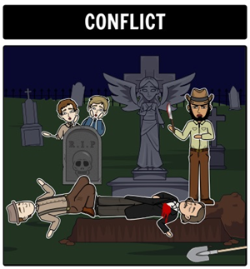
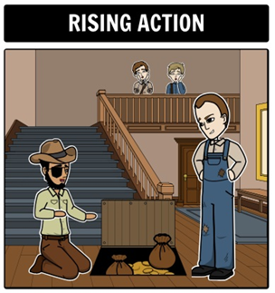
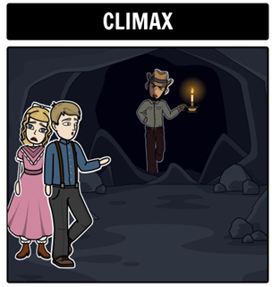
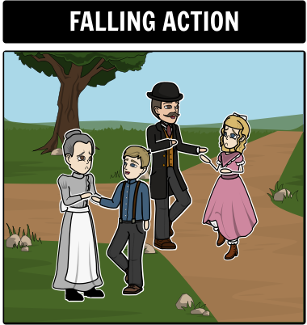
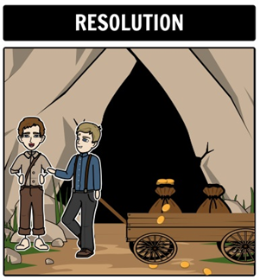
STORY PLOT WITH IMAGES
Tom Sawyer lives with his Aunt: Polly. When Tom skips school he does adventures with his friends.
During one of Tom’s adventures with Huck they go in the graveyard and Injun Joe kills the doctor.
Injun Joe hides his treasures and Tom and his friends spy he.
Becky and Tom were in the cave and they see Injun Joe.
Tom and Becky go back from the cave.
Tom and Huck find the Injun Joe teasure’s and Huck go to Widow Douglas’s home.

Slide 25
The Themes of the story
Boyhood rebellion and growing up
The hypocrisy of adult society
Superstition, fantasy and escape
Showing off
Sentimentality and realism

Slide 26
THE CHARACTERS OF THE STORY

Slide 27
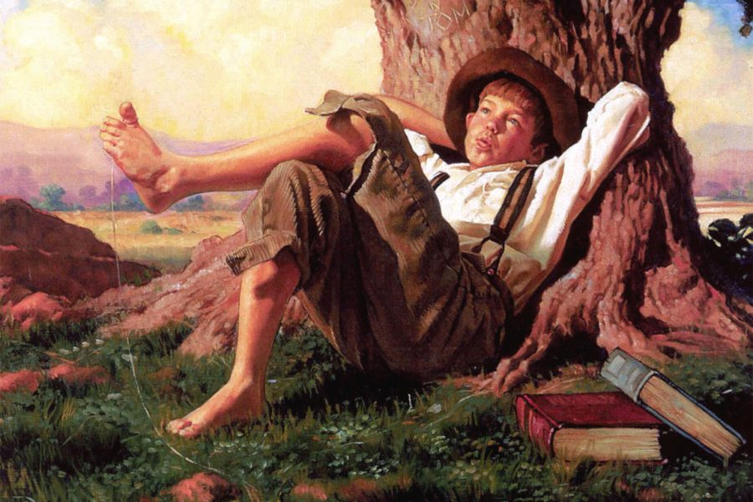
Tom Sawyer
By Paolo Mirarchi 2B

Slide 28
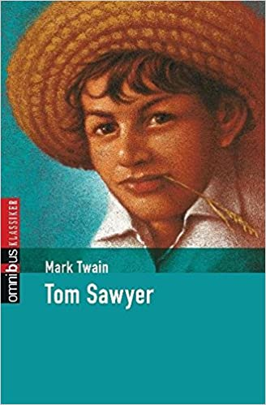
Physical Appearance
Personality
Tom Sawyer, the young protagonist has brown hair, a farmer’s hat and cheeks full of freckles
Tom is a very nice boy and when he wants something from others, he gets it cleverly , and never does what his Aunt Polly tells him.

Slide 29
Curiosity
This is the story of the adventures of a boy who lives in the south of the United States in a period of time just before the war of seccession. Most of the adventures reported actually happened.

Slide 30
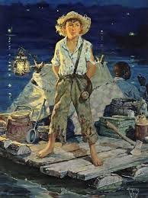
Hucklebbery finn
Huckleberry Finn - The son of the town drunk. Huck is a juvenile outcast who is shunned by respectable society and adored by the local boys, who envy his freedom. Like Tom, Huck is highly superstitious, and both boys are always ready for an adventure.

Slide 31
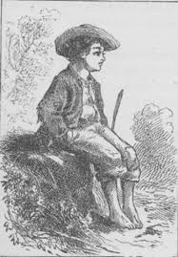
Joe Harper
Joe Harper - Tom’s “bosom friend” and frequent playmate. Joe is a typical best friend, a convention Twain parodies when he refers to Joe and Tom as “two souls but with a single thought.”

Slide 32
Becky Thatcher
By Sofia Paone Falvo 2A

Slide 33
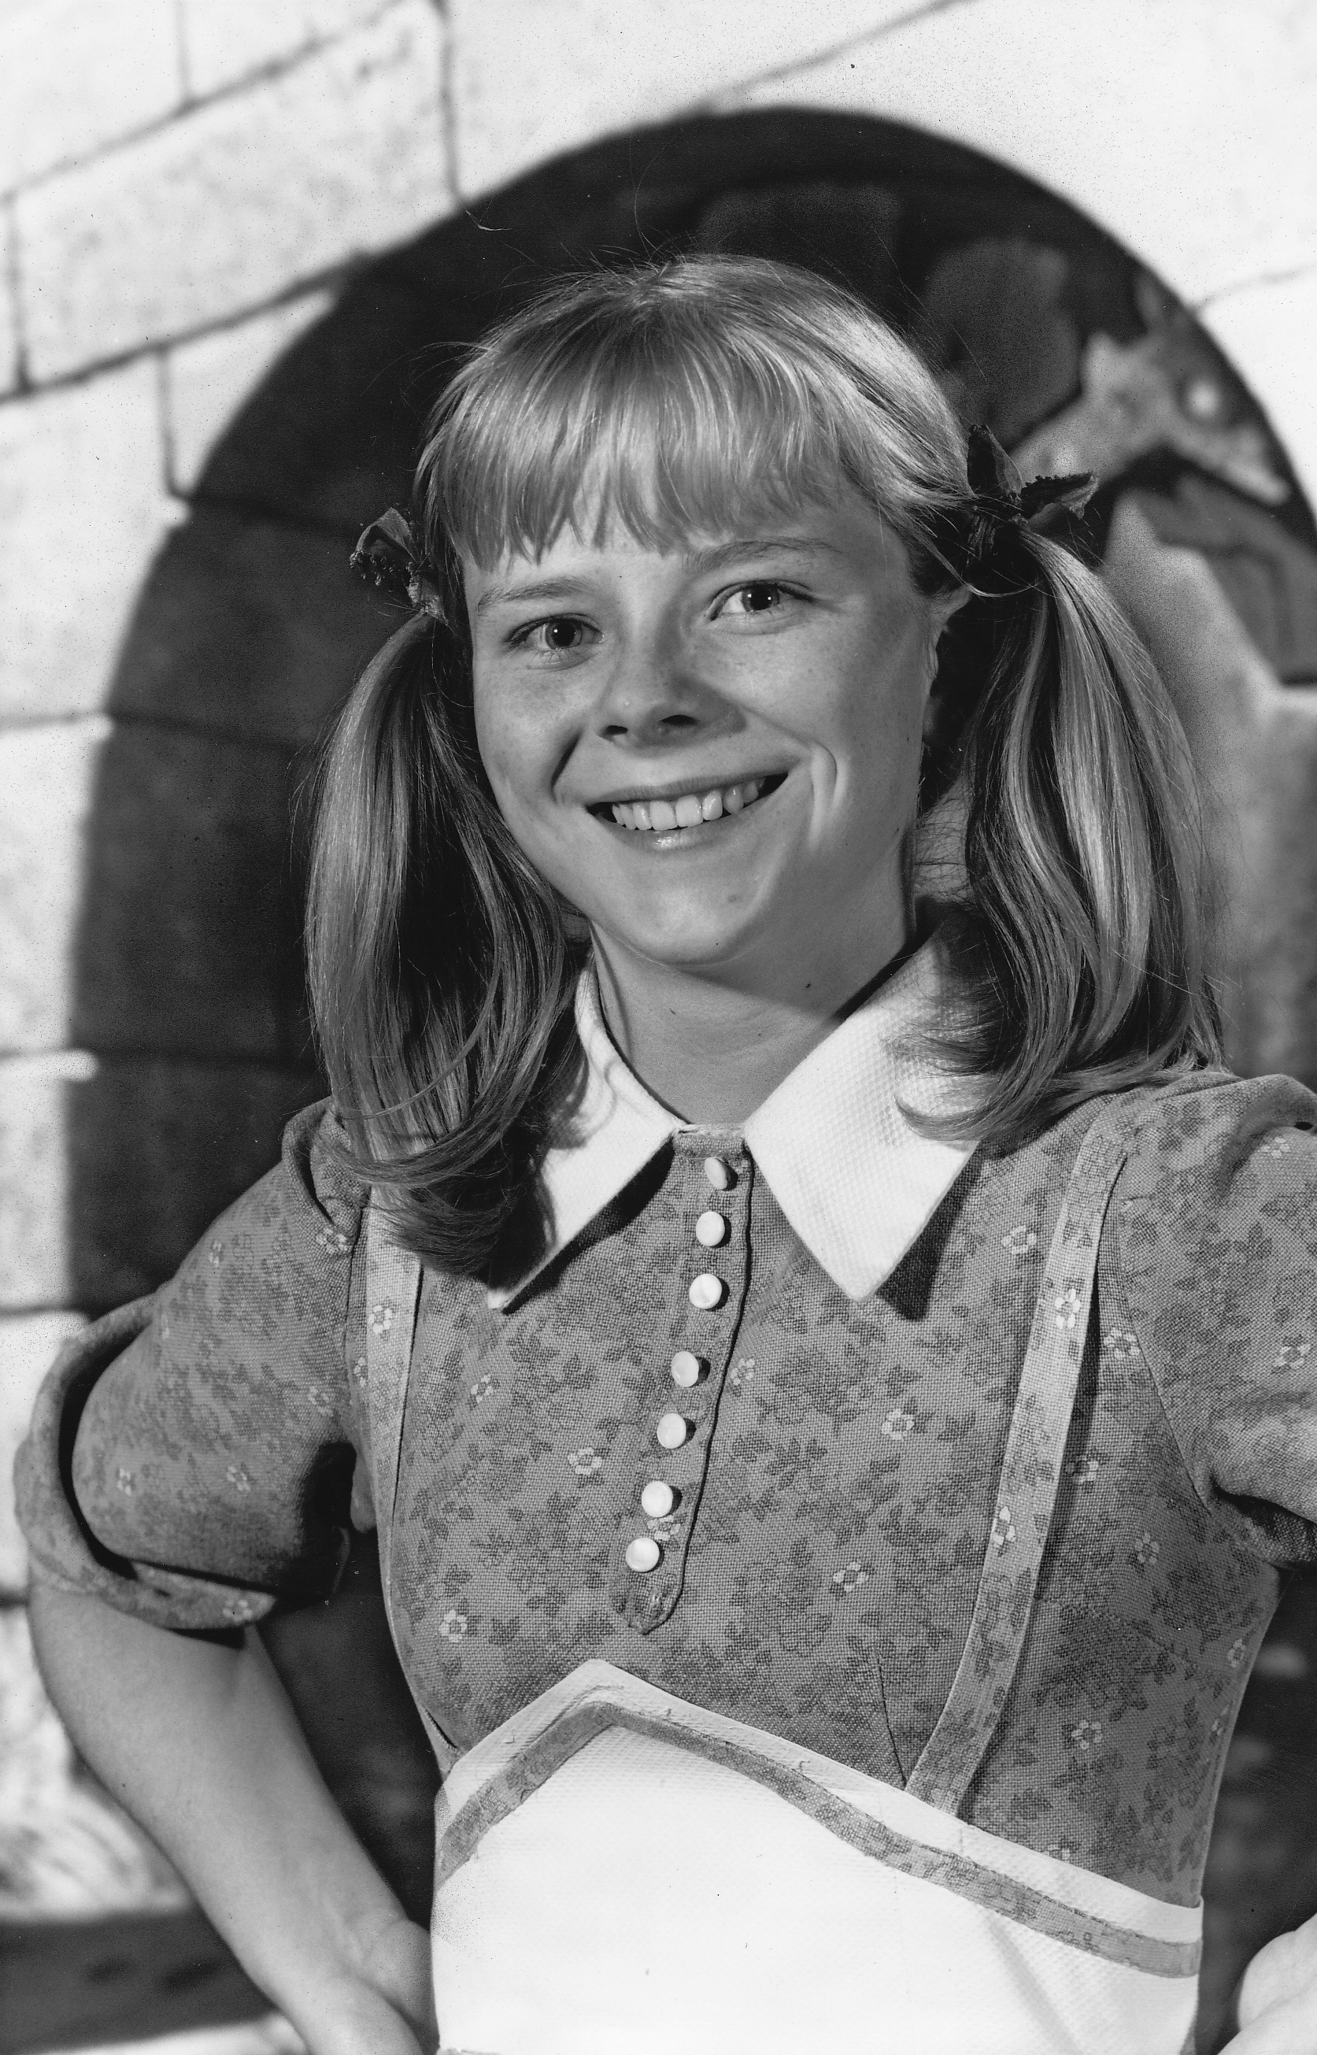
Presentation of Becky!
FEATURES: Becky is the daughter of Judge Thatcher, her hair is described as "yellow" and very long and her eyes are blue.
RELATIONS: She and tom fall in love and swear to be together forever thanks to a kiss. She believes that Tom still loves Amy but he takes the blame of the teacher’s torn book to convince her that he loves her.
WHO IS SHE: She is the new girl in the class, she is sweet and nice and her name in Italian means Rebecca or "to tie“.
CURIOSITY: In the book Huckleberry Finn the name is also referred to as "Bessie". Becky was based on Laura Hawkins, a true friend of Samuel Clemens.

Slide 34
A new adventure…
Chapter 1: The strange girl
Huck and the boys were in a park this time, hiding in a tree and talking about a new adventure to do. They saw two men following a girl. they went to help the girl but they found something else. The girl was missing. They went around the park but they didn't find anyone, the park was deserted. They hid everything but couldn't keep it inside for too long…………TO BE CONTINUED…

Slide 35
DESCRIPTION OF AUNT POLLY
By Daria Gualtieri 2B

Slide 36
WHAT DOES AUNT POLLY DO?
-She is Tom’s guardian.
-She lives with Tom and takes care of him.
-She gives Tom everything he needs.
-She tries to educate him and make Tom a good boy.
-Aunt Polly scolds Tom to help him understand his mistakes.
-She raises Tom like her son.
PERSONALITY TRAITS
She is: kind, severe when needed, affectionate to Tom, available, she has maternal instinct.
PHYSICAL APPEARANCE
She is old and a little bit fat. She is humble, shabby and wears glasses. Aunt Polly has wrinkles on her face and her hair is blonde.

Slide 37
INJUN JOE DESCRIPTION
By Allison Placido 2C

Slide 38
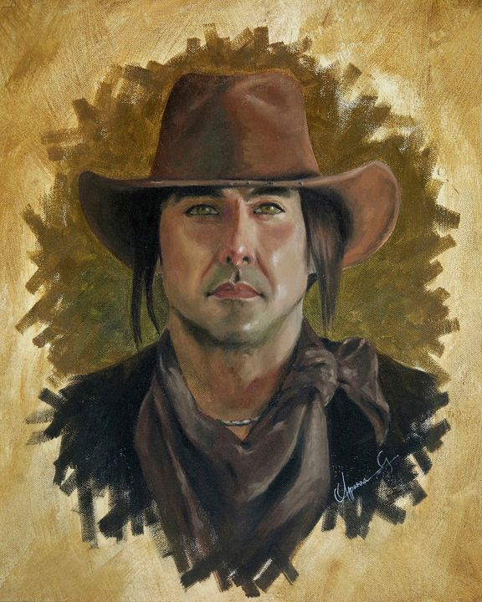
WHO IS HE?
This is Injun Joe, the main villain or antagonist of the novel "The Adventures of Tom Sawyer". His behavior forces Tom and his friends to deal with injustice and crime. He is also half Native American, and has faced discrimination in society.
PERSONALITY
Injun Joe is cold-hearted, cruel, remorseless and very dangerous. Like the stereotypical Native American half-blood, he is deeply antagonistic towards the town citizens. And he is also willing to kill people for money and/or treasure.
APPEARANCE
Injun Joe is dressed in a ragged shirt with a soot dark blue jacket covering it. On his head is a wide-brimmed dark brown hat.
By Allison Placido 2C

Slide 39
Muff Potter
By Marta Bagnato 2A

Slide 40
Physical Appearance
Middle-aged
Curly hair
Moustache
Old clothes
Calm expression
Personality Traits
Alcoholic
Friendly
Hearty
He loves children
Naive
Relations to Others
Partner of Injun Joe
Friend of Tom and Huck - (they helped him when he was in jail)
For everyone he is the old town drunk
Character’s role
He is accused of the doctor’s murder wrongly. (Injun Joe killed the doctor)

Slide 41
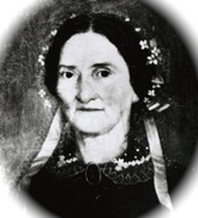
Widow Douglas

Slide 42
Widow Douglas
Physical Appearance:
She has long,straight brown hair.
She was very beautiful when she was young.
Personality Traits:
She is rich.
She is very kind.
She is very loving.
Relations to Others:
She is a widow.
She is a highly respected member of St. Petersburg community.
She is Huck’s stepmother.

Slide 43
Mr. Jones
By Efrem Boccuto 2B

Slide 44
Mr. Jones is a Welshman who lives near the home of his widow Douglas with his two children. Mr. Jones is a kind man who listens to Huck when he tells him about Injun Joe's intention to attack the widow. He saves widow Douglas when Injun Joe decides to kill her.

Slide 45
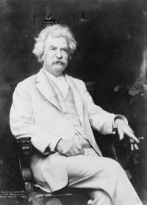
«A successful book is not made of what is in it, but of what is left out of it»…
«Un libro di successo non è fatto di ciò che c’è dentro di esso, ma di ciò che è rimasto fuori.»
Mark Twain

Slide 46
Final Impressions
«The strangest English PON in the world……a profound study about an interesting and famous novel via DAD……I never expected it!!! Every afternoon «having coffee» with my teacher who until yesterday seemed far away from my world and now I consider almost as family. The PON changed from a school activity to a discussion between friends who read the same book. The character of the book The Adventures of Tom Sawyer that I liked most is Huck, because in his small way, even if he isn’t the main character, he silently managed to destroy the plans of the antagonist Injun Joe.»
Domenico Coppola 2B

Slide 47
THE END

